Slide 1



PRESENTATION
By Canada Group
Group Members:
Dipendra Kandel
Subhadra Pokhrel
Shanta Sharma
Dinesh Dhakal
Shyam Bahadur Magar

Slide 2

Background
History:
In the 1500s and 1600s, the French started colonies. Later, the British took over in the 1700s. In 1867, Canada became its own country, and in 1982, it became fully independent.

Slide 3

Contd.
Politics:
In the 1500s and 1600s, the French started colonies. Later, the British took over in the 1700s. In 1867, Canada became its own country, and in 1982, it became fully independent.

Slide 4

Contd.
Geography:
Continent: North America
Size: Second-largest country in the world by land area after Russia Area: 9,98,4,670
(approx. 9.98 million km²)
Neighbor: Mexico and the United States of America

Slide 5
Contd.
Other Information:
Dialing Code: +1 (001) &amp; Internet Domain of the country: .ca
CAD1 = Nrs. 98.50 (Buy) and Nrs. 98.93 (Sell) @ 2025 May 25
Official Religion: None / Christianity Dominant
Symbol: Mapple Leaf

Slide 6

Contd.
Other Information:
Language: English, French...
Capital City: Ottawa (in Ontario)
Date Format: YYYY/MM/DD
Driving Side: Right
Time Zone: There are 6 time zones from UTC -03.30 to -08:00 (Standard)
Nationality: Canadian

Slide 7
Contd.
Demography/Population:
Total Population: Approximately 40.7 million (2025)
Population Growth Rate: Around 1.1% A
Growth is driven primarily by immigration rather than natural increase (birth-death)
Population Rank: 37 As of 2024 &amp; Density: 4.3 / Sq. km.

Slide 8
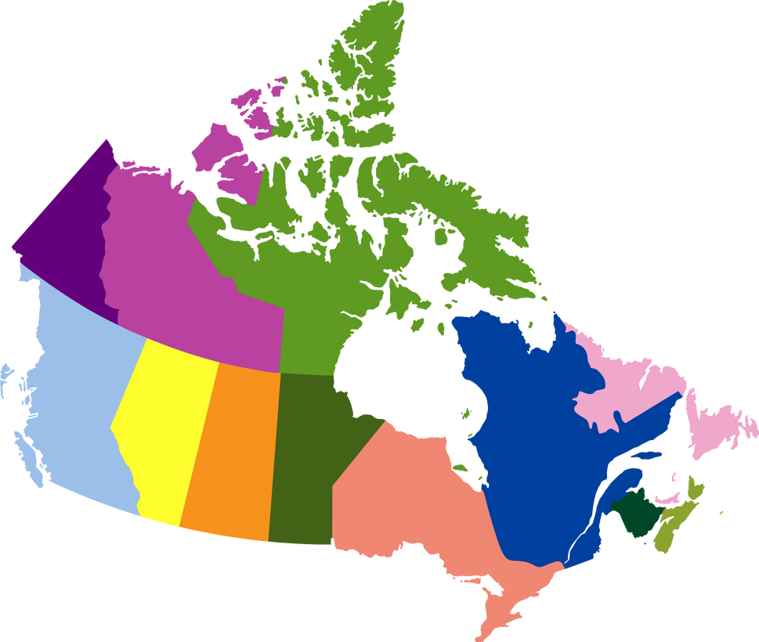
Contd.
Provinces:
Canada has ten provinces and three territories.
Each province and territory has its own capital city.
Alberta: Edmonton & Calgary
British Columbia: Victoria & Vancouver
Manitoba: Winnipeg & Winnipeg

Slide 9
Contd.
Provinces:
New Brunswick: Fredericton & Moncton
Newfoundland and Labrador: Capital: St. John's & Largest City: St. John’s
Nova Scotia: Capital: Halifax & LC: Halifax
Ontario: Capital Toronto & LC: Toronto
Prince Edward Island (PEI): Charlottetown & Largest City: Charlottetown

Slide 10
Contd.
Provinces:
Quebec: Capital: Quebec City & Largest City: Montreal
(Quebec is a large, predominantly French-
speaking province in eastern Canada)
Saskatchewan: Capital: Regina & Largest City: Saskatoon

Slide 11
Contd.
Territories:
Yukon: Capital: Whitehorse & Largest City: Whitehorse
Northwest Territories: Capital: Yellowknife & Largest City: Yellowknife
Nunavut: Capital: Iqaluit & Largest City: Iqaluit

Slide 12

Contd.
Economic Status:
Currency: Canadian Dollars (CAD) / 1USD = 1.37375 CAD
One of the world’s most developed countries with a high standard of living and a strong, diverse economy.
GDP (Gross Domestic Product): $2.3 Trillion USD, the ninth largest economy

Slide 13
Contd.
Economic Status:
Per Capita Income: Approximately $55,890 USD
Major Economic Sectors: Services (~70% of GDP), Industry (~ 28% of GDP), Agriculture (~ 2% of GDP)
Trade: Highly trade-dependent, especially with the United States of America

Slide 14
Contd.
Global Knowledge Index: 2024
GKI 2024: 12/141 and 64.5/100
Pre University Education: 1/141 and 90.2/100
Higher Education: 21/141 and 58.2/100
Research, Development and Innovation: 23/141 and 44.7/100
Economy: 8/141 and 70.5/100

Slide 15

Education System
Canada is known to have one of the best education systems in the world.
Canada’s provincial and territorial governments are responsible for education.
They follow government standards to ensure high quality public education.

Slide 16
Contd.
National Qualification Framework (NQF)
No centralized national qualifications framework (CQF)
Each province/territory manages its own education system through a National
Example: Education System of Alberta, Education System of British Columia, etc.

Slide 17
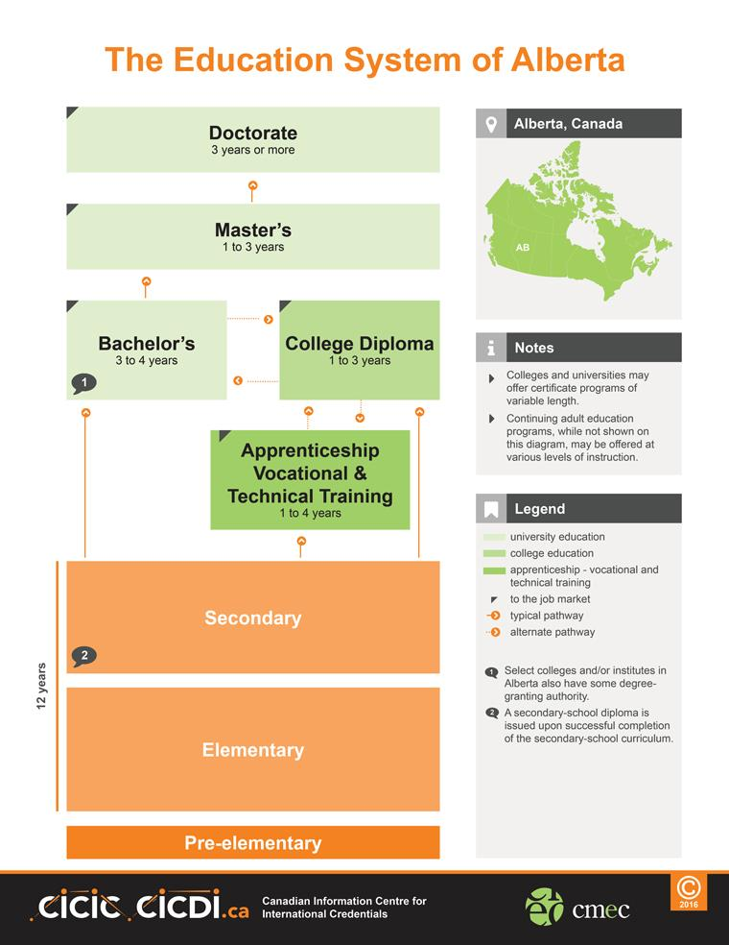



Slide 18
Contd.
Type of Academic Institutions in Canada
Universities: Offer undergraduate and graduate degrees
Colleges: Focus on diplomas, certificates, and applied degrees
Polytechnics and Institutes: Practical and technical training

Slide 19
Contd.
Type of Courses
Diploma and Certificate programs
Undergraduate degrees (Bachelor's)
Graduate degrees (Master’s and PhD)
Professional programs (Law, Medicine, etc.)
Language programs (English or French)

Slide 20
Contd.
Top 5 Universities in Canada
University of Toronto / Top 25 in the world
McGill University / Top 29 in the world
University of British Columbia (UBC) / Top 38 in the world
University of Alberta / Top 96 in the world
University of Waterloo / Top 115 in the world

Slide 21
Contd.
Top 10 Courses in Canada
Computer Science / Aviation and Aerospace Studies / Business Adm. & Mgmt. / Engineering / Nursing and Health Sciences / Hospitality & Tourism / Media and Communication Studies / Environmental Science / Law and Public Policy / Education and Teaching

Slide 22
Contd.
Fee Structure
Undergraduate Tuition: CAD 15,000 – CAD 30,000 per year
Graduate Tuition: CAD 18,000 – CAD 35,000 per year
Living Expenses: Around CAD 20,635 per year (may vary by province and lifestyle)

Slide 23
Contd.
Scholarships in Canada for Intl. Students
Merit-based scholarships from Uni.
Government scholarships
Research scholarships (especially for Master’s and PhD)
Some common scholarships:
a) Vanier Canada Graduate Scholarships
b) Trudeau Foundation Scholarships

Slide 24
Accreditation System in Canada
Institutional Accreditation (Recognition):
Public institutions are automatically accredited by provincial legislation
Program Accreditation:
Engineering: Engineers Canada
Nursing: Canadian Association of Schools of Nursing (CASN)

Slide 25
Academic Requirements
Bacheor’s Degree (Federal)
12 years of education
Minimum 60–70% or equivalent GPA
Proof of English: IELTS 6.0–6.5 Academic
Tuition Fees: CAD 15,000 – CAD 30,000/year
Living Expenses: CAD 20,635/year

Slide 26
Contd.
Master’s Degree (Federal)
4-year Bachelor's degree (3-year degrees may be accepted in some cases)
Minimum GPA: 3.0/4.0 or 65–70%
English: IELTS 6.5–7.0
Research proposal (for research-based programs)

Slide 27
Contd.
Master’s Degree (Federal)
GRE (for STEM/research programs) or GMAT (for MBA/management)
Work experience (especially for MBA/MPA)
Tuition: CAD 18,000 – 35,000/year
Living Expenses: CAD 20,635/year

Slide 28

Required Documents to Get an offer letter
What is an Offer Letter?
An offer letter is an official document from a university or college confirming that you have been accepted.
Common Required Documents for Offer Letter:
Completed Application Form
Valid Passport (for international students)
Academic Transcripts and Certificates
Statement of Purpose (SOP)

Slide 29
Contd.
Common Required Documents (contd)
Letters of Recommendation (LORs)
English Language Proficiency Scores (IELTS, TOEFL, etc.)
Curriculum Vitae (CV) or Resume
Application Fee Receipt

Slide 30
Contd.
Statement of Purpose (SOP)
Introduce yourself and your academic background
Why are you applying for this program?
Career goals and plans
Why this university?

Slide 31
Contd.
Letter of Recommendation
2-3 letters from professors or employers
On official letterhead, signed and dated
Must highlight your strengths, qualifications, and character

Slide 32
Contd.
English Language Proficiency
IELTS, TOEFL, PTE scores
University-specific minimum scores
Waiver if previously studied in English

Slide 33
Contd.
Submitting Documents
Through university portals or application systems
Scan in high quality (PDF preferred)
Ensure clarity and legibility

Slide 34
Contd.
Summary Checklist
Application Form
Academic Transcripts
SOP
LORs
Language Proficiency
Resume
Optional Documents (as needed)

Slide 35

Immigration Rules and Regulations of Canada
Governed by the Immigration and Refugee Protection Act (IRPA)
Allows foreign nations to enter Canada in various pathways
Designed to balance economic needs, social needs, humanitarian commitments and national security of the country and its people

Slide 36
Contd.
Strict Policy on Student Visa Regulations
In 2025, annual cap is 4,37,000 which was 4,85,000 in 2024
Students should hold a valid study permit from Designated Learning Institution (DLI)
Students should leave Canada after their course completion

Slide 37
Contd.
Six New Rules for International Students from 2024
Updated Post Graduate Work Permit (PGWP) Criteria
Increased Off - Campus Work Hours
End of Flagpoiling for Post Graduate Work Permit (PGWP) Applications
Termination of the Student Direct Stream (SDS)

Slide 38
Contd.
New Restrictions on Spousal Open Wor Permits
New Study Permit Application Rules

Slide 39

Required Documents for Visa Application
Proof of Payment - Study Permit Fee (150 CAD), Biometric Fee (85 CAD) and
University or College Tuition and Fees Receipt
Photocopy of valid passport
Two rececent photos
Letter of Acceptance (LOA)
Provincial Attestation Letter (PAL) or Territorial Attestation Letter (TAL)

Slide 40
Contd.
Quebec Acceptance Certificate
Proof of Financial Support
Medical Exam
Photocopy of Marriage License / Certificate, if applicable
Other important documents such as Resume, Statement of Purpose (SOP), Academic documents and IELTS or PTE.
Any additional documents such as Police Report

Slide 41

Points to be Consider for Documents
The document that are not in English or French needs to be translated by a certified Notary Public
Affidavit is required to state that the translation is an accurate version of the original text

Slide 42

Required Forms for Visa Application
Application for Study Permit made Outside of Canada (IMM 1294)
Family Information (IMM 5707)
Statutory Declaration of Common–Law Union (IMM 5409), if applicable
Use of a Representative (IMM 5476), if applicable
Authority to Release Personal Information to a Designated Individual (IMM 5475), if applicable

Slide 43
Contd.
Custodianship Declaration – Custodian for Minors Studying in Canada (IMM 5646), if applicable

Slide 44

Points to be Consider for Forms
All forms should be electronically signed and dated by students who are 18 years or older
For minors, any parents or legal guardian can sign the forms.

Slide 45
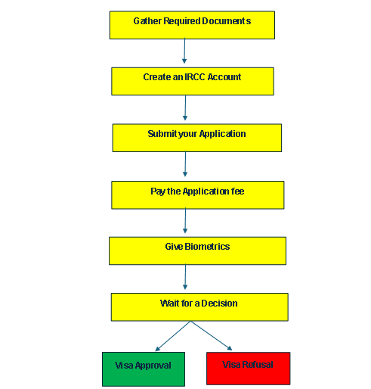
Visa Application Procedure

Slide 46

Conditions attached with Visa
In Case of Visa Approval
Student will receive PPR letter (i.e Original Passport Request)
Student will submit passport through VFS Global
The student gets its passport collection email within (next) thirty business days
In the meantime, we do pre-departure counselling to the student from the time of enrollment until....

Slide 47

Contd.
In Case of Visa Refusal
Absence of enough ties/why gonna come back to home country
Inadequate financial documents.
Irrelevant Course
Not convincing the visa officer that the applicant is leaving Canada when study ends.
Inconsistencies or missing documentation

Slide 48
Contd.
In Case of Visa Refusal
Misrepresentation
The course selection/SOP university selection was not sufficiently justified in the personal statement.
Insufficient language proficiency score due to the sudden change of language proficiency requirement.

Slide 49
Contd.
The Conditions or Consequences after Visa Refusal
Refusal Letter
You get the refusal letter outlining the reasons of refusal.
The purpose of this letter is improving or fixing mistakes in your next application or a reapply process.

Slide 50
Contd.
The Conditions or Consequences after Visa Refusal
Optional but you may find GCMS Notes useful
You are entitled to get your GCMS notes so that you get the entire reasoning why you are blocked.
It assists you in understanding the refusal.You are required to pay NPR 3400 to request for the GCMS note and it takes 30 days to receive the response of GCMS note.

Slide 51
Contd.
The Conditions or Consequences after Visa Refusal
Impact on Future Application
Future visa applications will be affected and asking for potential previous refusals, which must mention date of refusal for seeing the future visa applications (to Canada or any other countries)
You have to disclose all refusals honestly, failure to do so in considered as misrepresentation which may cause a negative impact on visa

Slide 52
Contd.
Conditions attached in case of non -refund by university
Common Conditions for Non-Refund by Universities after Visa Refusal
Missed Refund Request Deadline
Non-refundable Fees
Lacking Documents Related to Refusal of Visa
Started The Program
A conditional offer or Pathway programs

Slide 53
Contd.
Third-party Agreements
Refund Requested — (No withdrawal)
Partial Refund Policy Partially refundable

Slide 54

Student Care Issues & Tuition Refund Policies
Student Care Issues
Mental Health and Wellbeing
Housing and Accommodation
Financial Strain
Academic Pressure and Support
International Student Vulnerabilities
Health Care Access
Safety and Discrimination

Slide 55

Contd.
Tuition Refund Policy After Vsa Refusal
Full or Partial Refund
Documentation Required
Refund Deadline
Application/Registration Fees
Refund Processing Time

Slide 56

Pre Departure Information
As educational counselors, our job is not only to help students obtain admission, but also to support them with making sure they are prepared for all aspects of the journey.

Slide 57
Contd.
Travel Documentation Requirements
Valid Passport - Expiry Date >6 months)
Letter of Acceptance - From Designated Learning Institute
Valid Visa
Proof of Financial Support, eg. Bank Statements to cover tuition and living expenses
Medical Insurance Documents

Slide 58
Contd.
Arrival Procedures
Port of Entry (POE) Letter of Introduction
Customs and Immigration Clearance Process
Declaration of funds and goods
Currency over CAD $10,000 (must be reported to avoid penalties)

Slide 59
Contd.
Arrival Procedures
Valuable goods (eg. electronics, jewlery) they are bringing into Canada
Food, plants or animal products (many are restricted)

Slide 60
Accommodation and Living Arrangements
Financial Planning
Tuition and Living Expenses
Ensure sufficient funds for tuition housing, food, transportation, and emergencies
Banking In Canada:
Open a Canadian Bank Account upon arrival for easier transactions

Slide 61
Contd.
Financial Planning
Currency Exchange:
Cary some Canadian Dollars for initial expenses

Slide 62
Health Insurance and Medical Requirements
Provincial Health Coverage:
Some provinces provide health insurance for international students (eg. OHIP in Ontario after a waiting period)
Vaccinations:
Check if any additional vaccinations are required
Prescription Medications
Bring necessary medications with a doctor’s note

Slide 63
Academic Expectations and Support Services
Orientation Programs:
Importance of attending university/college
Orientation Academic advising and course registration
Canadian Academic Culture:
Plagiarism and Academic integrity policies
Classroom and participation expectations

Slide 64
Immigration Rules and Regulation
On-Campus work:
Unlimited hours if enrolled full-time at a DLI.
Off-Campus work: Up to 20hrs/week during academic sessions, full-time during scheduled breaks
Co-op/internships:
Requires a seperate work permit if part of the program

Slide 65
Contd.
Post-Graduation Work Permit (PGWP)
Eligible after completing a program (8 months-3 years, depending on program length).

Slide 66
Safety and Legal Responsibilities
Emergency Numbers:
911 is the universal emergency number for police, fire, and medical help
Campus Security:
Most universities have 24/7 security patrols and emergency call boxes

Slide 67

Career Outcome and Work Right
Employment Rates of Internatioal Students
90% find employment within 6 months of graduation (Statistics Canada 2023)
76% transition to permanent residency within five years (IRCC, 2023)

Slide 68
PGWP Requirements
Program Duration
Study program must be at least 8 months long
Shorter course do not qualify
Full-Time Status
Students must have full-time enrollment
Application Timing
Students must apply within 180 days of receiving their final grades or completion letter

Slide 69
Contd.
Valid Study Permit
Must have held valid Study Permit during their studies

Slide 70
Duration of PGWP
Program Shorter than 8 months
No Eligibility for PGWP
Program between 8 months and 2 years
PGWP duration matches the study period (Eg. 1 year program = 1 year PGWP)
Program of 2 years or Longer
Graduates Teceive 3-year PGWP, maximum available

Slide 71
Contd.
Multiple Credentials
If completes more than one eligible program, they combine lengths (Eg. Two 1-year Program = 2 years PGWP)

Slide 72
Contd.
Top Industries Hiring International Graduates
Industry % of Hires
Information and Technology (IT) 25%
Healthcare 18%
Business and Finance 15%
Engineering 12%
Education 8%

Slide 73
Salary Expectations
Entry-Level (0-2 years exp.): 40,000-60,000 CAD/year
Mid-Career (3-5 years exp.): 60,000-90,000 CAD/year
Senior-Level (5+ years exp.): 90,000-120,000 CAD/year (Especially in high-demand fields like IT and Engineering)

Slide 74
Pathways to Permanent Residency (PR)
Express Entry (Canadian Experience Class - CEC)
Express Entry system is the fastest way to obtain PR for Skilled Workers

Slide 75
Eligibility For PR
At least 1 year of Skilled work experience in Canada
CLB7 (Canadian Language Benchwork) in English or French (IELTS 6.0 GT or equivalent)
Comprehensive Ranking Systems (CRS):
Points are awarded for age, education, work experience, and language proficiency
Recent CRS cutoffs range between 470-500 points

Slide 76
Other Immigration Pathways
Rural and Northern Immigration Pilot (RNIP)
For graduates working in smaller communities
Quebec Experience Program (PEQ)
Requires French Proficiency (B2 level) and Quebec work experience
Carigiver and Agri-Food Pilot Programs
Alternative options for eligible candidates

Slide 77
Challenges Faced by International Graduates
Work Permit Delays
PGWP processing can take months
Delaying job starts
Employer Hesitation
Some Employers prefer permanent residents over temporary work permit holders
Job Market Competition:
Major cities like Toronto and Vancouver have high competition for entry-level roles

Slide 78
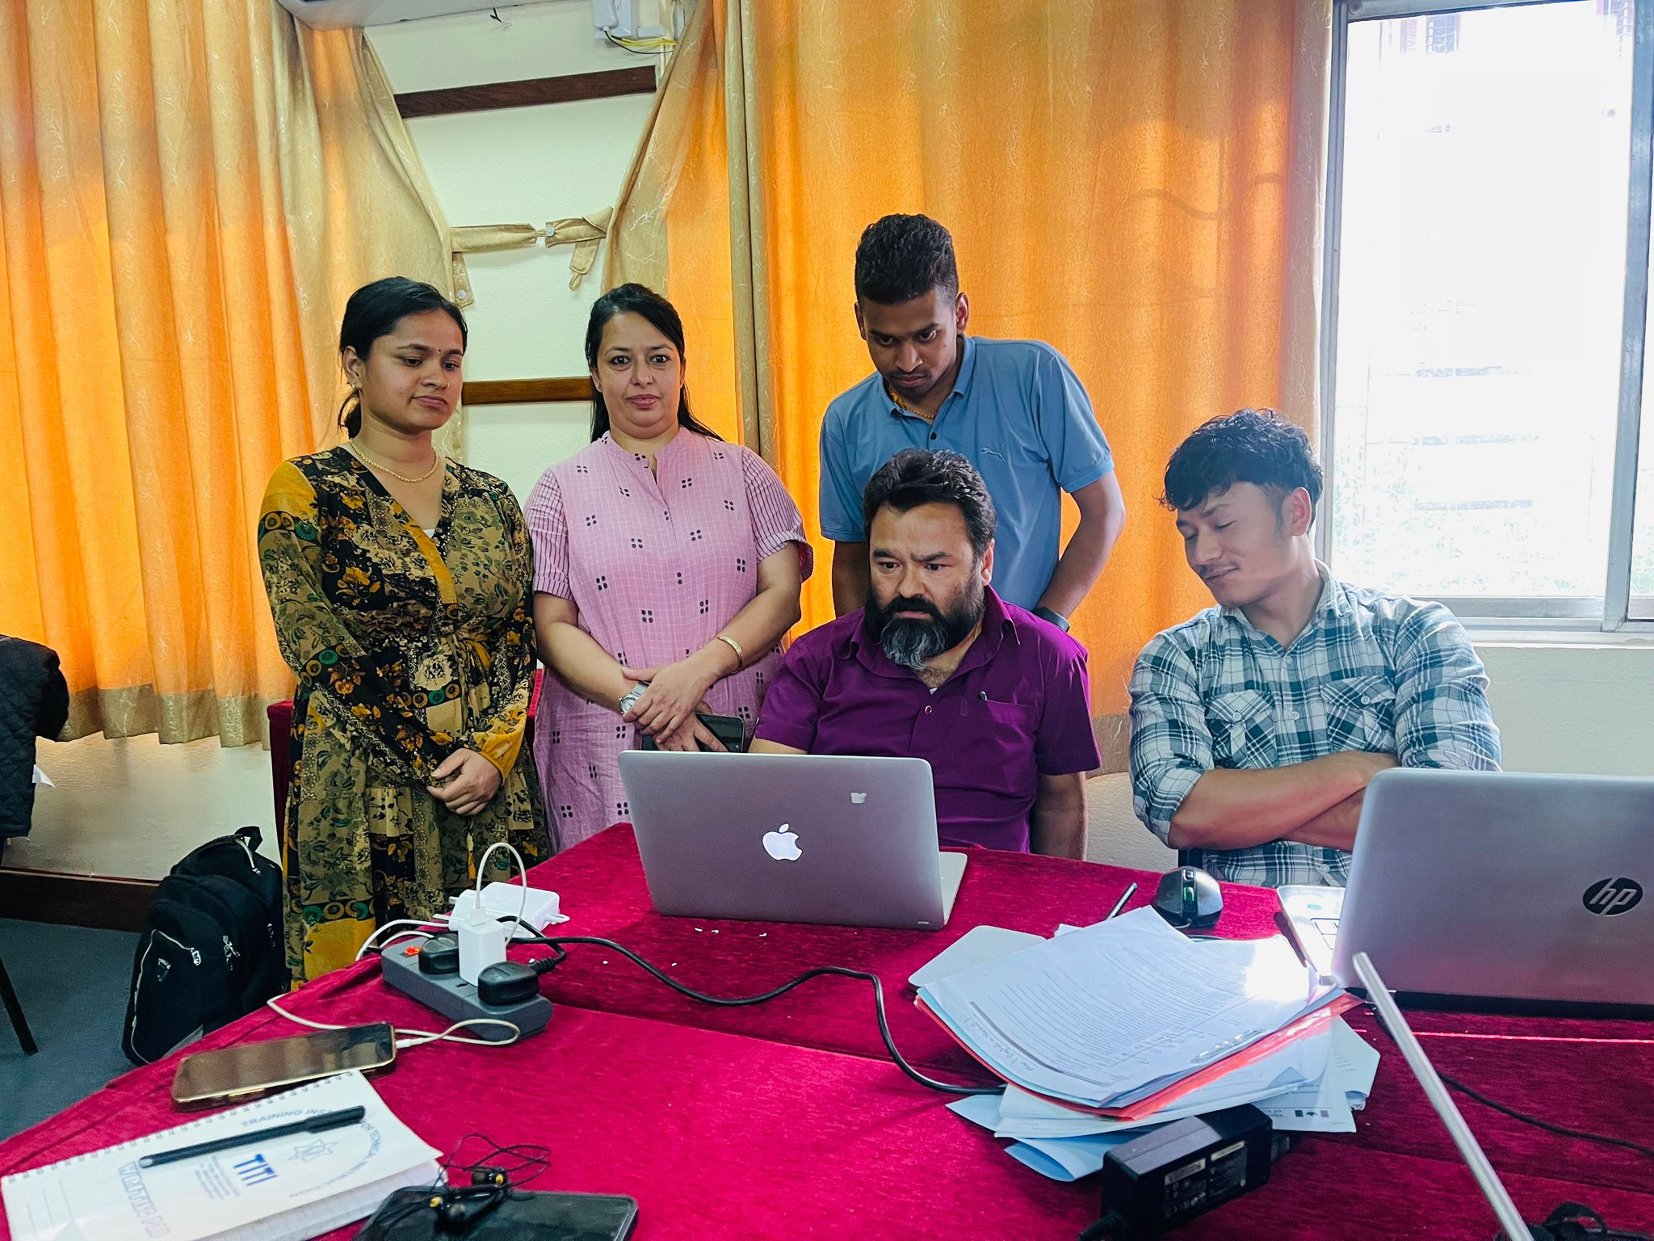
Our team – our strength

Slide 79

Any Questions?

Slide 80

THANK YOU

